Slide 1

Data Science Job Profile Analysis
Michelle Heredia

Slide 2
Background and Goal:
I conducted an analysis of the https://www.kaggle.com/datasets/arnabchaki/data-science-salaries-2023 dataset to analyze the profiles of data scientists. The goal of my analysis was to showcase trends in level of compensation, prevalence of remote work, location, and experience level.

Slide 3
Exploratory Data Analysis

Slide 4

Exploratory Data Analysis
I performed exploratory data analysis to get a general idea of the data set. The goal of my exploratory data analysis was to determine what parameters I could analyze.

Slide 5
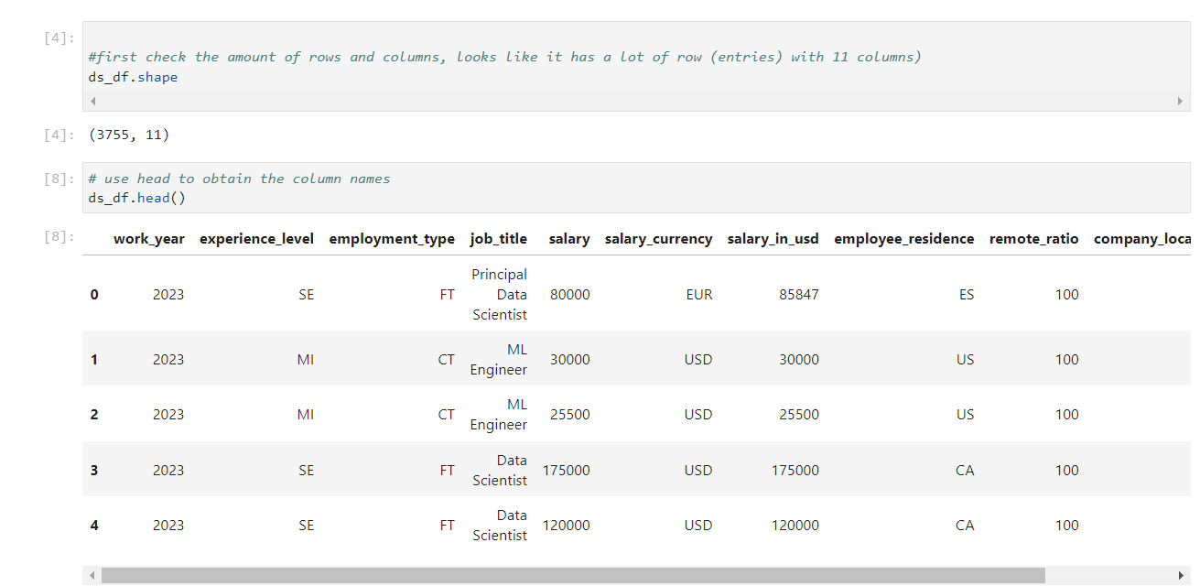
Exploratory Data Analysis
First, I started by obtaining the shape and the first few rows of the dataset. Based on my analysis, I was able to determine which initial parameters I wanted to look more into.

Slide 6
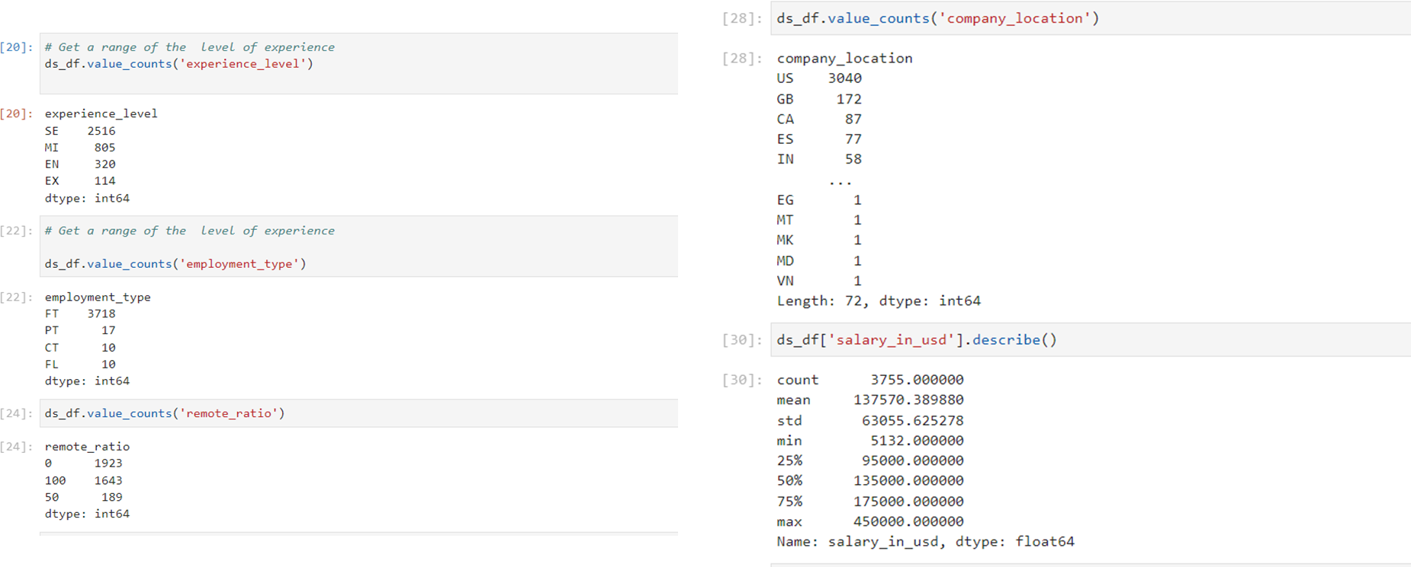
Exploratory Data Analysis
Then I explored each column I wanted to analyze to see what the data look like for each parameter I wanted to analyze (experience level, employment type, remote ratio, company location, and salary):

Slide 7
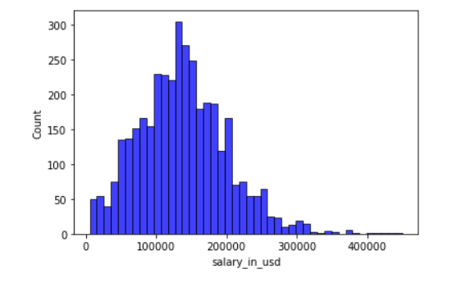
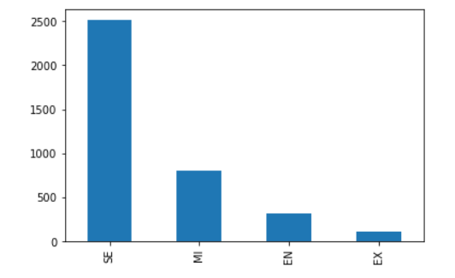
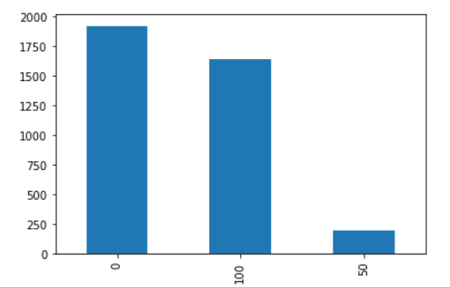
Exploratory Data Analysis
I then created visualizations of the data points I was particularly interested in (remote ratio, salary, and experience level):

Slide 8
Data Cleaning

Slide 9
Data Cleaning
Next, I cleaned the data so it could be analyzed properly.

Slide 10
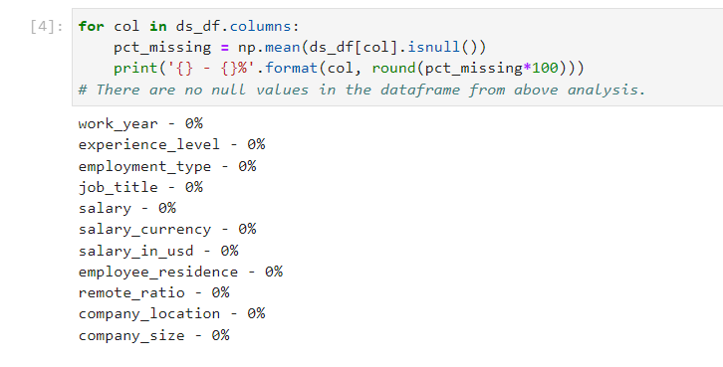
Data Cleaning
First, I tested for missing data and determined that nothing was missing.

Slide 11
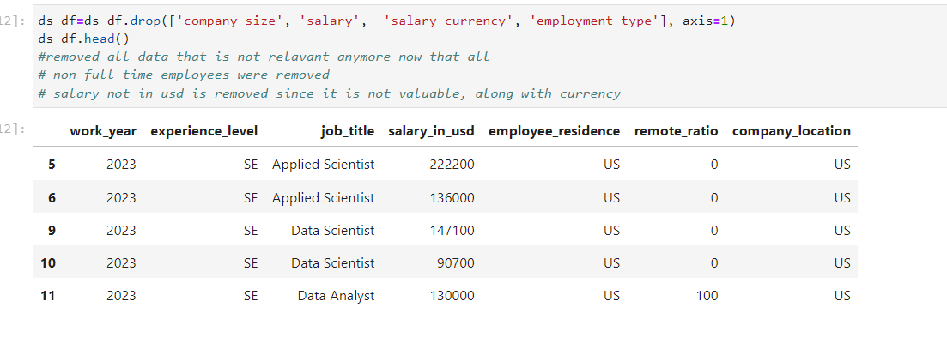
Data Cleaning
Next, I dropped any unnecessary data (removed columns that were not necessary to the analysis as determined in the EDA).

Slide 12
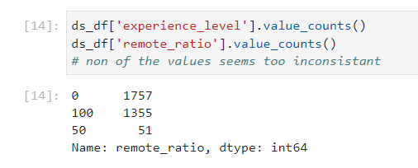
Data Cleaning
Next, I dropped any inconsistent data.

Slide 13
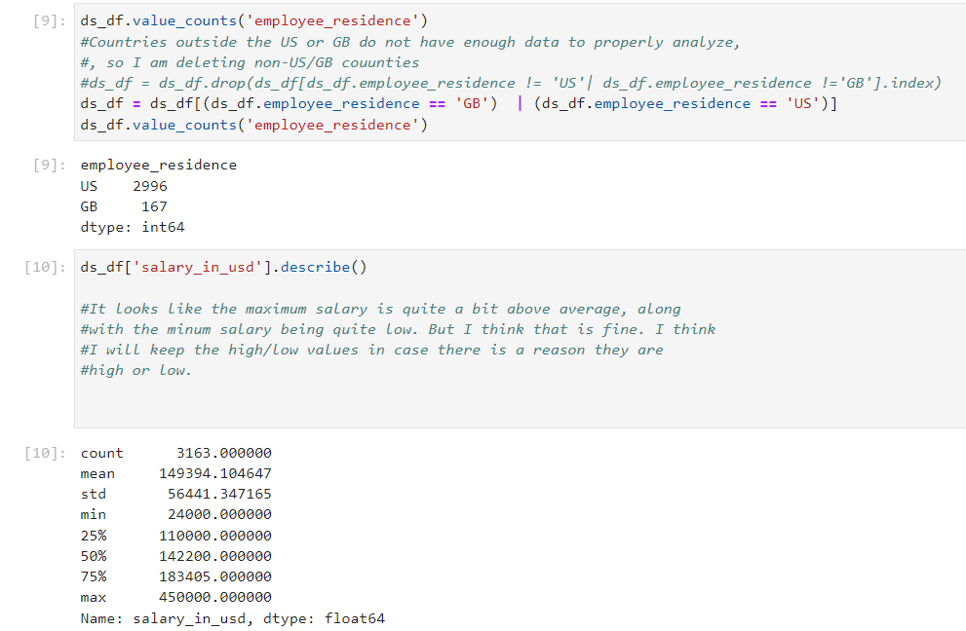
Data Cleaning
Finally, I dropped any irregular data.

Slide 14
Visualization

Slide 15
Visualization
I then performed visualizations of the cleaned data in Tableau.

Slide 16
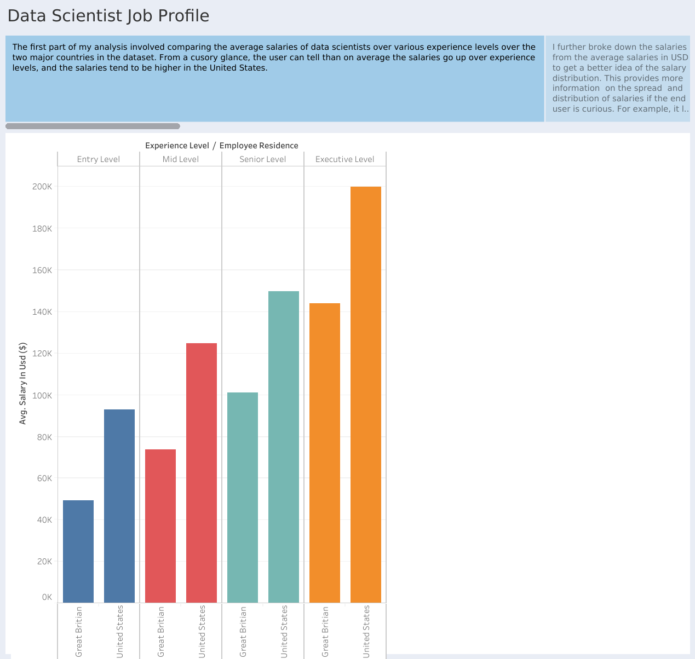

Slide 17
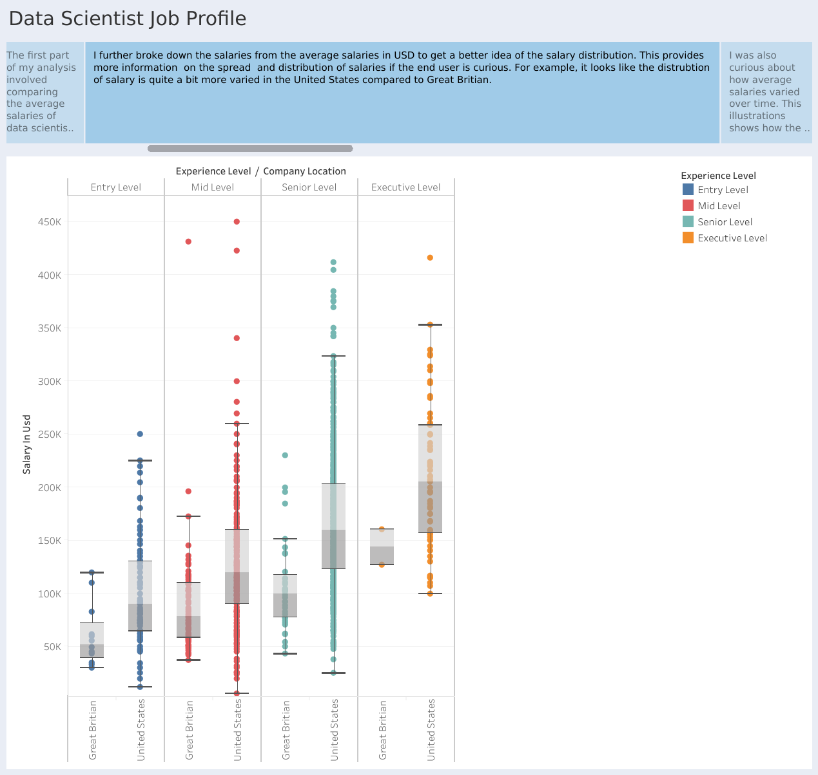

Slide 18
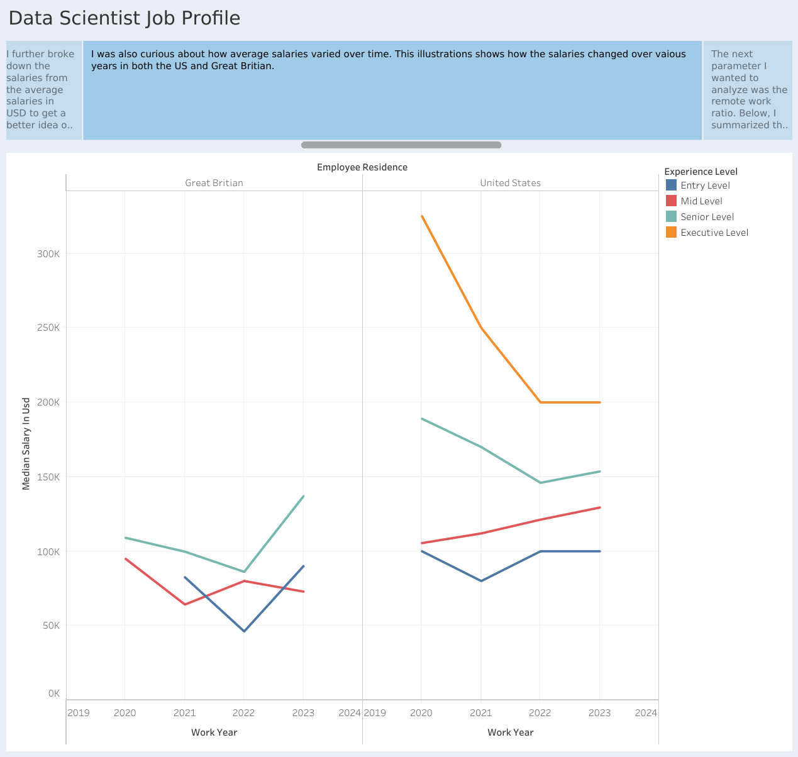

Slide 19
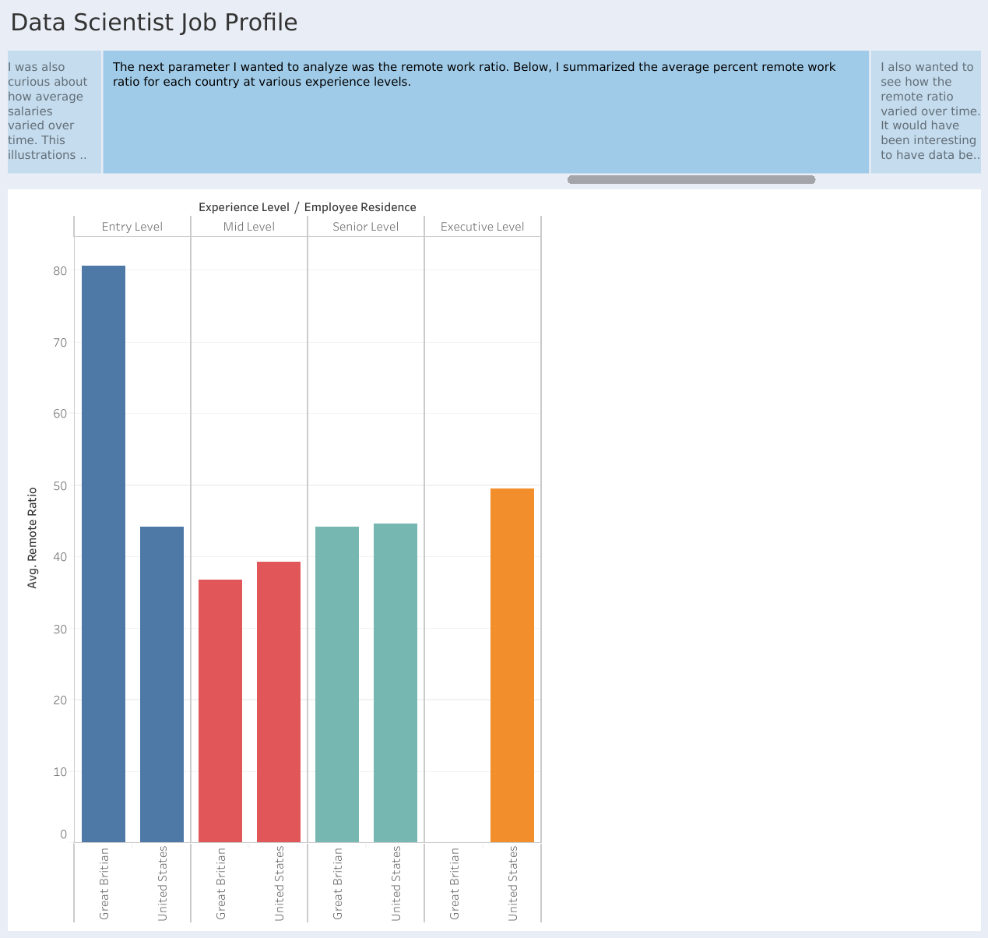

Slide 20
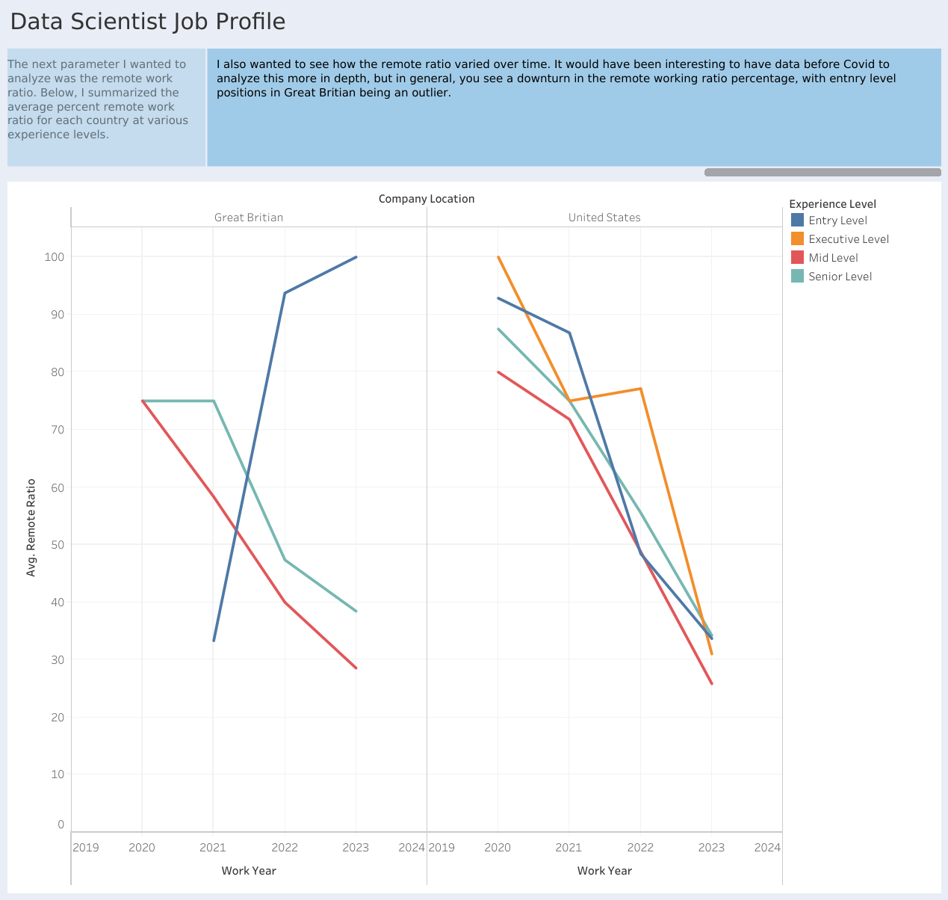

Slide 21
Regression

Slide 22
Regression
I then performed regression on my data.

Slide 23
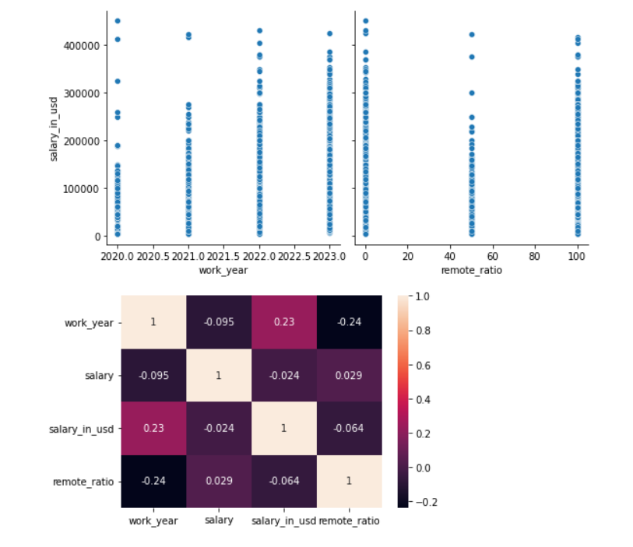
Regression
I first used pairplot and a heatmap to find which variables correlated the most strongly in the dataset (work year and salary):

Slide 24
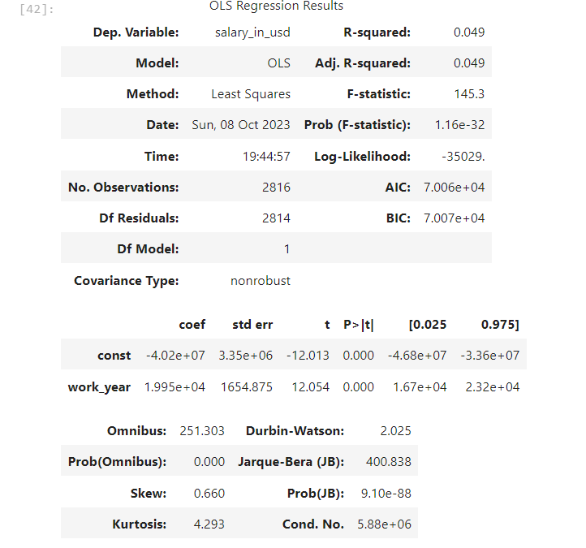
Regression
I then created and trained my model.

Slide 25
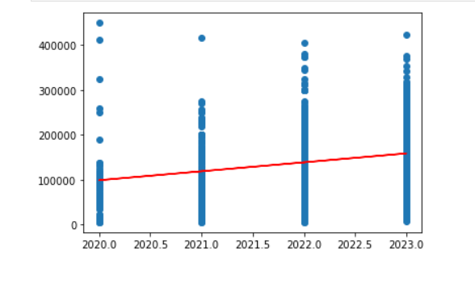
Regression
Finally, I plotted the results. Linear regression did not work well (R square value was only about 0.049), but I believe a different type of regression could have matched the curve a bit better.

